Slide 1


Drone Based Mapping and Ground Based Robotic Precision Spray System for Field Crops

Slide 2
Team Roles
Logan Sutton
Frontend UI design & implementations
Finalized api endpoint integrations
CI pipeline for backend tests
Docker CD pipeline
Gil Rezin
Field map processing into prescription
Clustering conversion into polygons
Vertex count
Polygon smoothing
Field map testing

Slide 3
Sprint 6 Objectives
Provide an installable application
Docker containers
Easy install script
Public access
Test Prescription Module
Comprehensive backend testing
Explore processing with varying parameters
Expose processing options to user
NodeODM enumerated settings
Prescription settings
Saved configuration
Overall: finalize major features; this is the final sprint

Slide 4
Sprint 6 Final Goals & Deployment
All core features implemented
Accessible to Andrew and public
Aligns with goal of free, accessible solution
System ready for real world testing
Unfortunately, Amiga issues prevented:
Pathing module testing
Autonomous transfer of path to robot
Final test
Undetermined prescription testing (as of writing this)

Slide 5
Overall Feature Implementation (Logan)
UI design (with AI)
Backend API routes and handlers
NodeODM integration and processing
Pathing module with Fields2Cover
Boustrophedon pathing
Conversion to farmng waypoints
Data storage and accessibility
Directory structure, organized by process guid
CI testing pipeline

Slide 6
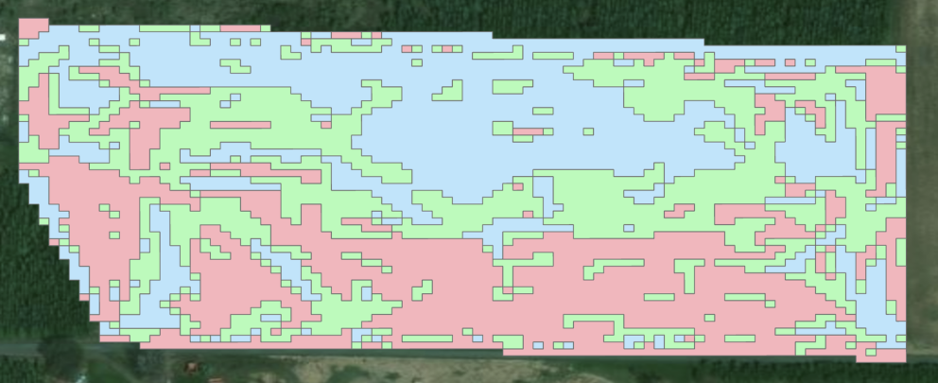

Overall Feature Implementation (Gil)
Prescription module
Written in R
FIELDimageR library as a base
R testing module
Data analysis prototyping methods
NDVI data analysis implementation
Data smoothing
DBSCAN clustering
Quantile bucketing
Amiga robot troubleshooting

Slide 7
Demo
Upload and NodeODM processing
Pathing generation
Initial generation and settings
Modification and downloading
Prescription generation
Generation and regeneration
Cluster, smoothing, GPA settings
Viewing jobs
Data persistence
Testing and CI pipeline

Slide 8
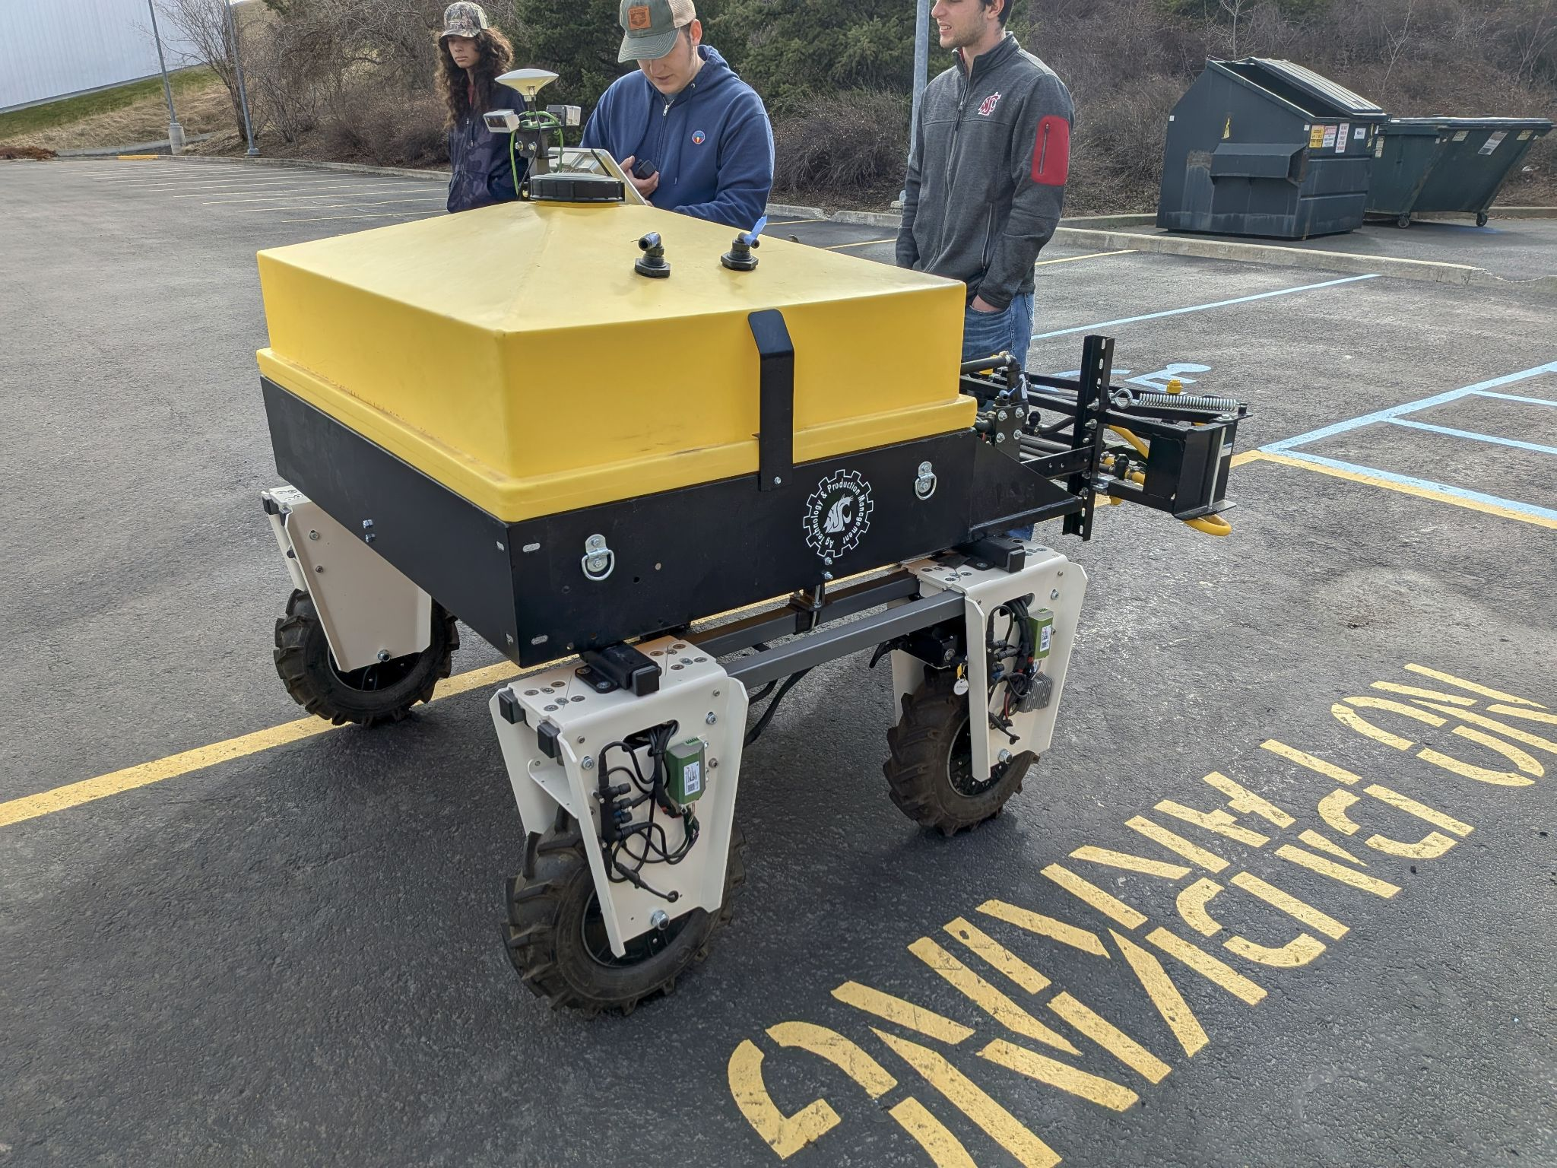
Project Deployment and Client Delivery
Docker containers provided on public GHCR
Install script provided in repo
CD pipeline setup for package generation
Steps for public install
Go to GH repository
Copy install and docker compose scripts
Run install script from same directory as docker compose

Slide 9
Kanban Board https://github.com/users/LoganSutton13/projects/3

Slide 10
Client Communication Documentation
DBD/docs/Mom/MoM_Apr_16_2026.md at main · LoganSutton13/DBD

Slide 11
Final Report Overview
Architecture
Use cases
Diagrams
Testing
(show final report .pdf)

Slide 12
Gen AI usage
Frontend creation and modifications
Entirety of frontend has been built this way, per client request
Utilized Cursor IDE
Backend refactoring
Brainstorm ideas on how to reimplement
“Rewrite this code to output y instead of x”
Writing unit tests
Provide a specific section of code to unit test
Does decently well, can’t give to big of task
Verification needed, as sometimes the generated test actually tests nothing
Assistance with debugging errors
MoM notetaking

Slide 13
Achievements and Challenges
Achievements
Publicly installable application
Dockerized and runs offline
Prescription module tested
Iterated through Kanban tasks
Bugs
Small features
Testing
Challenges
Pathing remains untested
No luck with amiga hardware
Trouble with getting path starting point setup
No autonomous pathing/prescription upload to amiga through app
Must be done through USB transfer
No functional test videos for video submission

Slide 14
Retrospective and Final Reflection
What worked well
UI development with AI
Prescription customizeability options
Prescription data analysis & processing
Pathing module (minus starting point)
Application works fully offline
What could have been improved
Functional testing on Amiga
Start testing earlier
Integrating system with Amiga communication
Lessons learned
Building a full stack offline agricultural application is fun but challenging
Generating a prescription from orthophoto works well with R using data analysis methods
How to integrating various libraries into cohesive unit
Requirement gathering from client and stakeholders

Slide 15
Thank you!
The system is publicly downloadable
Additional work/validation needed
Pathing corrections
Prescription is in correct format
File format accepted by Amiga
What is currently available
Orthophoto stitching given drone imagery
Prescription generation with GPA
Path generation and preview
Downloadable files
Containerized frontend and backend

